Slide 1
Presentation brief for MCT’s
Title of presentation | Azure Cognitive Services
Presentation length | 90 minutes.
Audience | Azure AI Engineers, Azure Developers.
Purpose | Introduce Azure Cognitive Services Outline the role of Cognitive Services in an AI solution
(think) Student key takeaways | The student should understand what the Azure Cognitive Services are and the role they play in Artificial Intelligence The student should have an appreciation of what Microsoft has already provided for “built-in” AI features for easy use The student should be able to understand the key roles that each service is geared toward
(feel) Student desired mindset | The student should understand why the Azure Cognitive Services are available The student should feel that this is overwhelming, but understand that the services are easy to use
(do) Student outcomes | The student should be able to select an appropriate service given a scenario The student should be able to articulate in one sentence description of each service (Speech, Vision, Language) The students should be able to describe the Adventureworks Case Study.
More information | For course feedback, please use the MCT Forums

Slide 2

AI-100T01A Module 01: Introducing Azure Cognitive Services

Slide 3
Agenda
Overview of Azure Cognitive Services
Creating Cognitive Services
Testing Cognitive Services
Lab: Implement Computer Vision

Slide 4



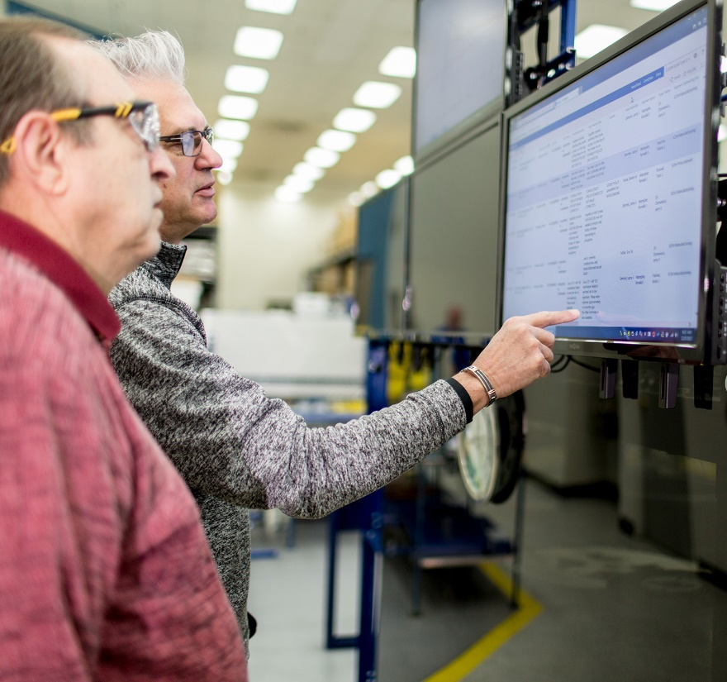









Lesson 01
Overview of Azure Cognitive Services
Data
Cloud
AI

Slide 5
Lesson Objectives
L01 – Introduce Computer Vision
L02 – Introduce Speech Services
L03 – Introduce Language Services
L04 – Introduce Search

Slide 6
Azure Cognitive Services and AI
Building an AI application from scratch can be daunting
Microsoft Azure Cognitive Services consist of
APIs
SDKs
Services
Core features includes:
Speech
Language
Vision
Search
Decision

Slide 7
Access Pre-Built Services
Vision
Speech
Language
Search
Decision
Your Apps

Slide 8
Introducing Vision
Vision
The current list of vision APIs are:
Computer Vision - The Computer Vision service provides you with access to advanced algorithms for processing images and returning information
Custom Vision Service - The Custom Vision Service allows you to build custom image classifiers.
Face API - Face API provides access to advanced face algorithms, enabling face attribute detection and recognition.
Video Indexer - Video Indexer enables you to extract insights from your video.

Slide 9
Introducing Vision, Cont’d
Vision
Services currently in preview:
Ink Recognizer - Used to recognize digital ink and handwriting
Form Recognizer - Extract text, key-value pairs, and tables from documents.

Slide 10

Computer Vision APIs – Tagging Images
Identifying and tagging visual features in an image
Vision
{
"tags": [
{
"name": "grass",
"confidence": 0.9999995231628418
},
{
"name": "outdoor",
"confidence": 0.99992108345031738
},
{
"name": "house",
"confidence": 0.99685388803482056
}
],
"requestId": "06f39352-e445-42dc-96fb-0a1288ad9cf1",
"metadata": {
"height": 200,
"width": 300,
"format": "Jpeg"
}
}

Slide 11

Computer Vision APIs – Detecting Objects
Returns the bounding box coordinates for each tag applied
{
"objects":[
{
"rectangle":{
"x":730,
"y":66,
"w":135,
"h":85
},
"object":"kitchen appliance",
"confidence":0.501
},
{
"rectangle":{
"x":523,
"y":377,
"w":185,
"h":46
},
"object":"computer keyboard",
"confidence":0.51
},
{
"rectangle":{
"x":471,
"y":218,
"w":289,
"h":226
},
"object":"Laptop",
"confidence":0.85,
"parent":{
"object":"computer",
"confidence":0.851
}
}
Vision

Slide 12

Computer Vision APIs – Detecting Brands
Identify commercial brands in images or videos
{
"brands":[
{
"name":"Microsoft",
"confidence":0.657,
"rectangle":{
"x":436,
"y":473,
"w":568,
"h":267
}
},
{
"name":"Microsoft",
"confidence":0.85,
"rectangle":{
"x":101,
"y":561,
"w":273,
"h":263
}
}
],
"requestId":"10dcd2d6-0cf6-4a5e-9733-dc2e4b08ac8d",
"metadata":{
"width":1286,
"height":1715,
"format":"Jpeg"
}
}
Vision

Slide 13
Computer Vision APIs – Detecting Brands
Vision
Identify and categorize an entire image, using a category taxonomy with parent/child hereditary hierarchies.
Categories can be used alone, or with our new tagging models.
Currently, English is the only supported language for tagging and categorizing images.

Slide 14

Computer Vision APIs – Describe an Image
Generate a description of an entire image in human-readable language, using complete sentences
{
"description": {
"tags": ["outdoor", "building", "photo", "city", "white", "black", "large", "sitting", "old", "water", "skyscraper", "many", "boat", "river", "group", "street", "people", "field", "tall", "bird", "standing"],
"captions": [
{
"text": "a black and white photo of a city",
"confidence": 0.95301952483304808
},
{
"text": "a black and white photo of a large city",
"confidence": 0.94085190563213816
},
{
"text": "a large white building in a city",
"confidence": 0.93108362931954824
}
]
},
"requestId": "b20bfc83-fb25-4b8d-a3f8-b2a1f084b159",
"metadata": {
"height": 300,
"width": 239,
"format": "Jpeg"
}
}
Vision

Slide 15
Computer Vision APIs – Detecting Other Aspects
Computer Vision can determine whether an image is black & white or color and, for color images, identify the dominant and accent colors.
Computer Vision can also detect adult material in images. Content flags are applied with a score between zero and one with values closer to 1 representing a greater confidence that the content is adult oriented*.
*also offered by the Azure Content Moderator service
Vision

Slide 16
Computer Vision APIs – Recognize Text
Read API - detects textual content in the supplied images and converts identified text into a machine-readable character stream.
Optical Character Recognition (OCR) - this feature is similar to the Read API but it operates synchronously and is not really optimized to perform OCR on large documents.
Vision

Slide 17
Introducing Speech
…
Speech
The speech APIs that are a part of the Azure Cognitive Services, provide specific functionality that can help your applications to work with speech
Text-to-speech
Speech-to-text
Speech translation

Slide 18
Text-to-Speech
…
Speech
Provides neural text-to-speech voices nearly indistinguishable from human speech (English).
Convert text to natural-sounding speech.
Offer multiple genders and/or dialects for many supported languages.
Support plain text input or Speech Synthesis Markup Language (SSML).

Slide 19
Speech-to-Text
…
Speech
Transcribe continuous real-time speech into text.
Batch-transcribe speech from audio recordings.
Support intermediate results, end-of-speech detection, automatic text formatting, and profanity masking.
Call on Language Understanding (LUIS) to derive user intent from transcribed speech.

Slide 20
Speech Translation
…
Speech
Speech Translation is designed to perform **real-time speech translation** for scenarios such as:
Live presentation translation
In-person or remote translated communications
Customer support
Business intelligence
Media subtitling
Multilingual AI interactions

Slide 21
Speech Translation
…
Speech
Walkthrough – Create a Speech Translation Subscription

Slide 22
Introducing Language
Language
The Language services available in the Azure Cognitive Services cover four main areas of focus and one preview feature:
Text Analytics
Translator Text
Language Understanding (LUIS)
QnA Maker
Immersive Reader (In Preview)

Slide 23
Introducing Language – Text Analytics
Language
The Text Analytics API is a Cognitive Service designed to help you extract information from text.
Through the service you can:
Identify language
Discover sentiment
Extract key phrases
Detect well-known entities from text

Slide 24
Introducing Language – Translator Text
Language
There are two aspects to this service, translator text and custom translator.
Translator Text is a cloud-based machine translation service you can use to translate text in near real-time through a simple REST API call
The customized translation system can be used to translate text with the Translator Text API or Microsoft Speech Services
* The API has support for more than 60 languages

Slide 25
Introducing Language – LUIS
Language
Language Understanding (LUIS) is a cloud-based API service that applies custom machine-learning intelligence to a user's conversational, natural language text to predict overall meaning, and pull out relevant, detailed information
LUIS makes use of three key aspects for understanding language:
Intent - An intent represents a task or action the user wants to perform. It is a purpose or goal expressed in a user's utterance.
Utterance - Utterances are input from the user that your app needs to interpret.
Entities - The entity represents a word or phrase inside the utterance that you want extracted

Slide 26
Introducing Language – QnA Maker
Language
Question and answer extraction from unstructured text
Knowledge base creation from collections of Q&As
Semantic matching for knowledge bases

Slide 27
Introducing Language
Language
Walkthrough - Call the Text Analytics API from the Online Testing Console

Slide 28
Introducing Search
Search
The Search aspect of Cognitive Services, at a high level, utilizes Bing as the search engine. Key aspects of the Search service are:
Bing New Search
Bing Video Search
Bing Web Search
Bing Autosuggest
Bing Custom Search
Bing Entity Search
Bing Image Search
Bing Visual Search
Bing Local Business Search (Preview)

Slide 29
Demo: Bing Search Services
Search
Bing Autosuggest – See how the autosuggest feature works when entering text
Bing Image Search – See an example of Bing results based on image searches and understand the various attributes available

Slide 30

Introducing Decision
Content Moderator - Use this service to detect potentially offensive content such as unwanted images, filter text for profanity or other unwanted text, and moderate content that might be considered adult or racy content.
Anomaly Detector (Preview) - This feature set can help you to monitor business health in real-time, leverage interactive data analytics for your business, and even help to conduct Internet of Things (IoT) remote monitoring.
Personalizer (Preview) - Personalizer helps to deliver richer personalized experiences in the applications that you develop. It can understand and manage the reinforcement learning loop and can be deployed anywhere from the cloud to the edge.

Slide 31
Content Moderator
Text Moderation - The service can evaluate written text to determine if it contains the following:
Profanity
Inappropriate text
Personally Identifiable Information (PII)
Information in custom term lists
Image Moderation
Use machine-assisted image moderation and human-in-the-loop Review tool to moderate images for adult and racy content.
Scan images for text content and extract the text.
Detect faces to aid in detecting personal data that may be contained in the images due to the recognition of faces in the images. You can match images against custom lists, and take further action.
The Optical Character Recognition (OCR) operation predicts the presence of text content in an image and extracts it for text moderation.
The Match operation allows fuzzy matching of incoming images against any of your custom lists, created and managed using the List operations. If a match is found, the operation returns the identifier and the moderation tags of the matched image.

Slide 32
Content Moderator, Cont’d
Video Moderation
Video-trained classifier (preview) - Microsoft's adult and racy video classifier is trained with videos
Shot detection - rather than just outputting frames, the service also provides shot-level data so you can review the video using shot-level or frame-level data
Key frame detection - the service identifies and outputs only potentially complete (good) frames. The feature makes frame-level adult and racy analysis easier and more efficient.
Visualization for human review - using the review tool, users can evaluate the insights of the video, change tags related to the video and perform many features associated with reviewing and evaluating video.
Transcript moderation - video files that will have transcripts or closed captioning require moderation to search for offensive speech. This option requires the use of the Azure Media Indexer to convert the speech to text, if the transcript files are not available, and then use the Content Moderator review API to scan the text in the review tool
Review Tool
A common set of tools to moderate text, image, and video.
Automate the creation of human reviews when moderation API results come in.

Slide 33

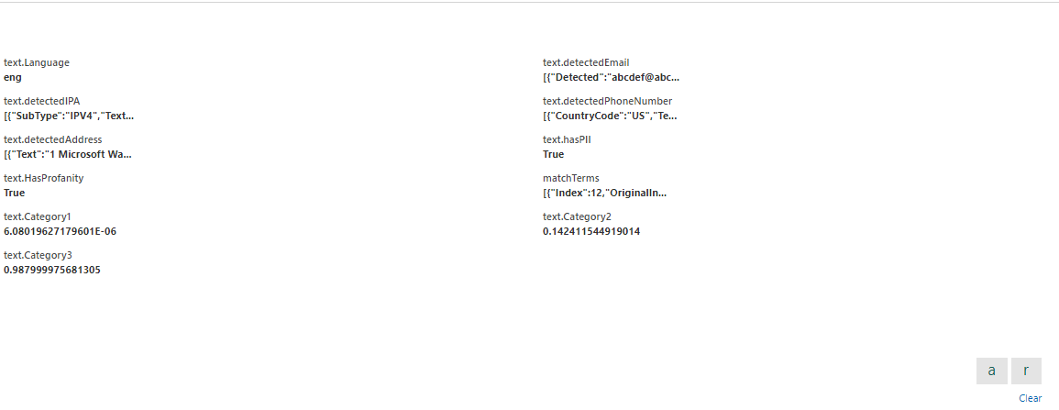
Demo: Content Moderator

Slide 34
Lesson 02
Creating Cognitive Services using the Azure Portal
Data
Cloud
AI

Slide 35
Lesson Objectives
L01 – Creating and Managing Cognitive Services Accounts

Slide 36
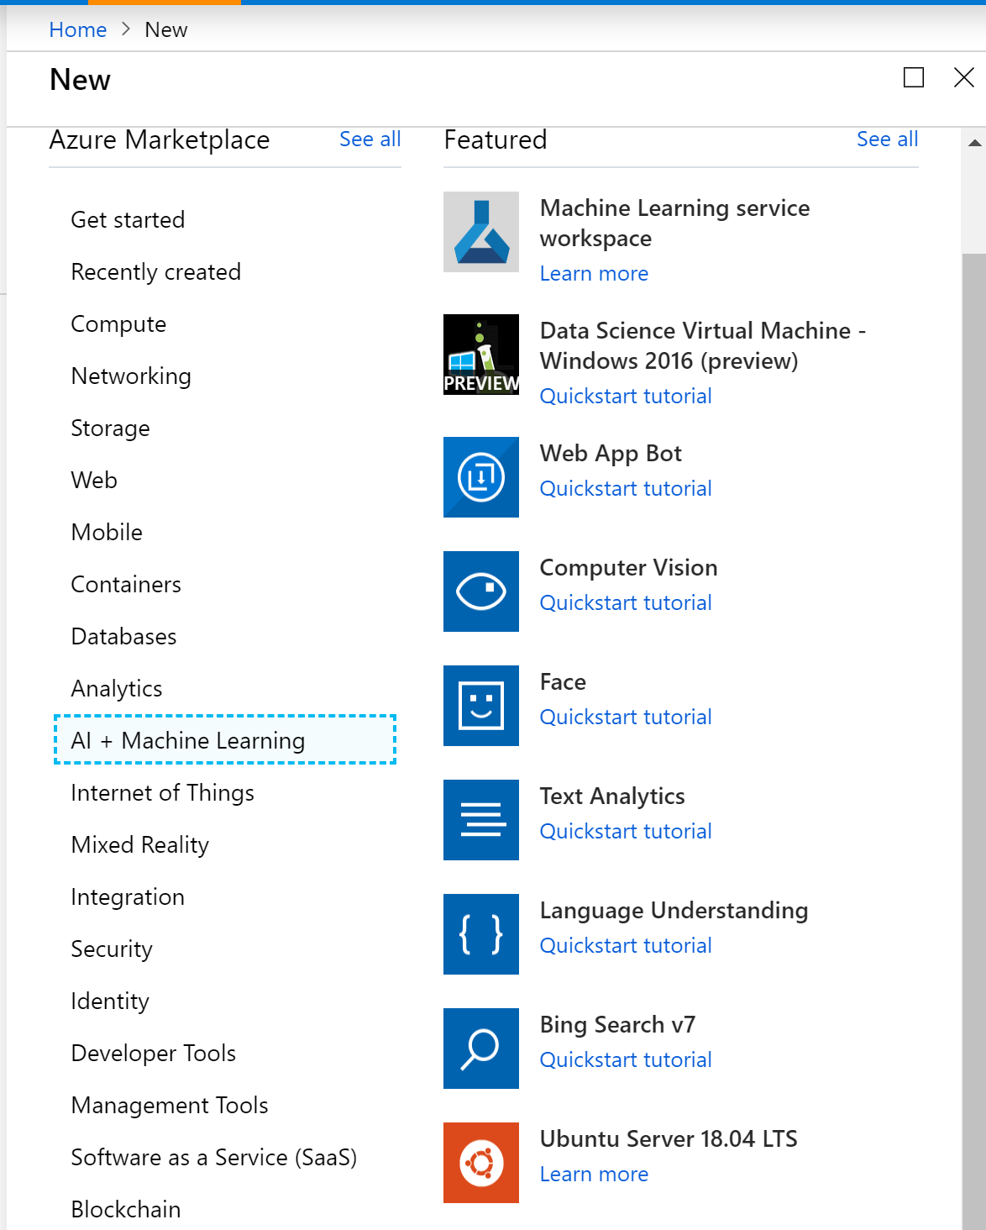
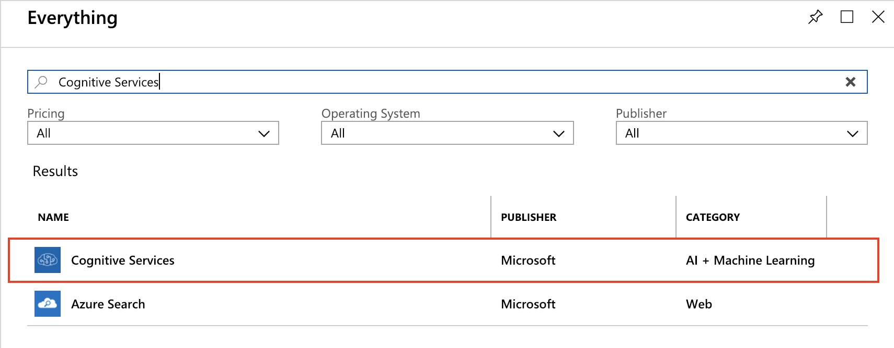
Cognitive Services Accounts
Create for single-service or multi-service usage
Notes:
Trainer note – demonstrate this in the Azure portal

Slide 37
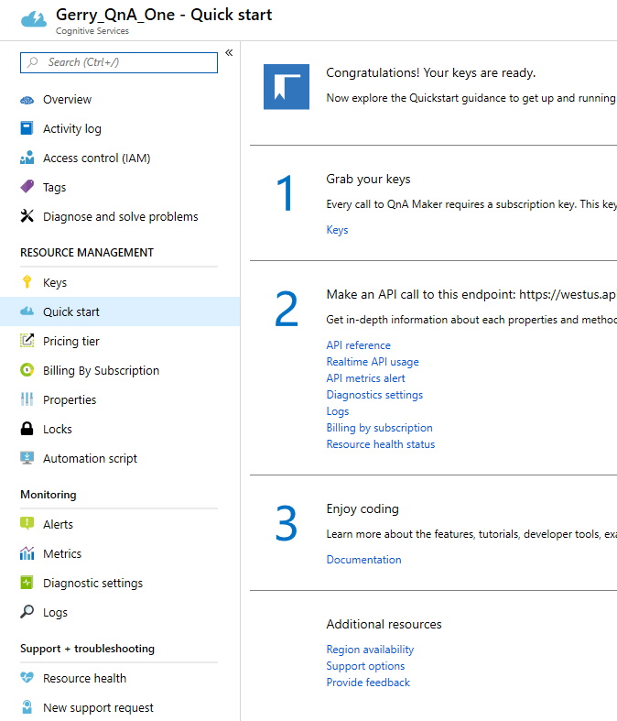
Manage Cognitive Service Accounts
Notes:
Trainer note – demonstrate this in the Azure portal

Slide 38
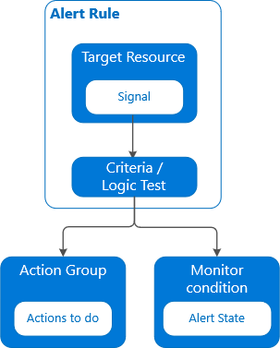
Monitor Cognitive Service Accounts
Notes:
Trainer note – demonstrate this in the Azure portal

Slide 39
Cognitive Services
Walkthrough – Create and Manage a Cognitive Services Account

Slide 40
Lesson 03
Testing Cognitive Services using the API Testing Console
Data
Cloud
AI

Slide 41
Lesson Objectives
L01 – Using the3 API Testing Console

Slide 42
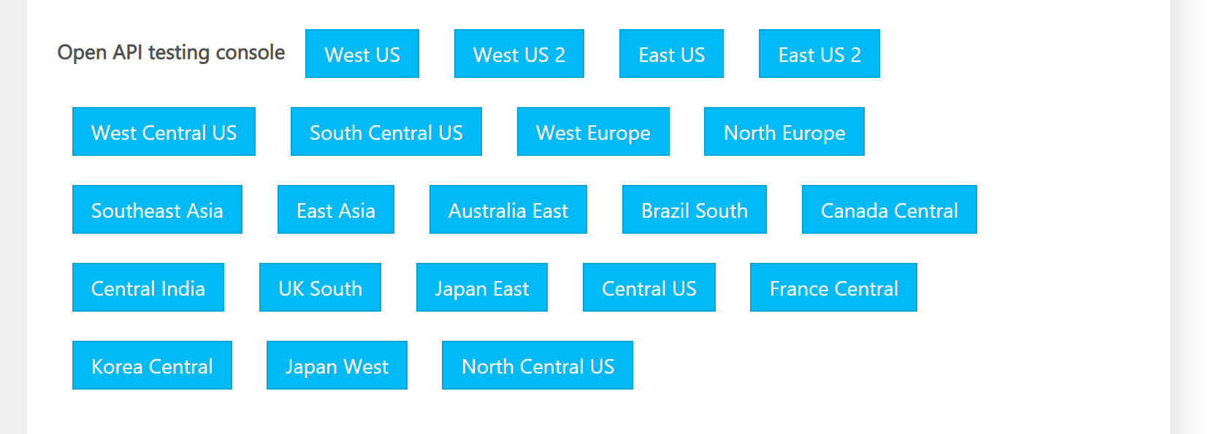
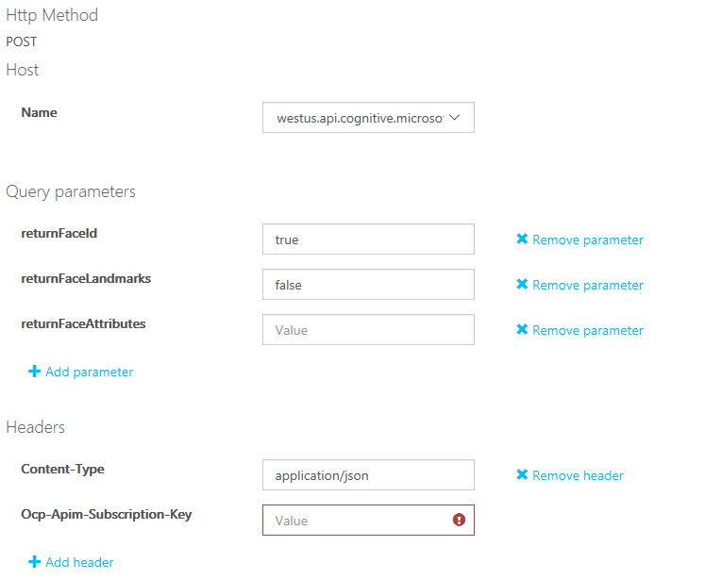
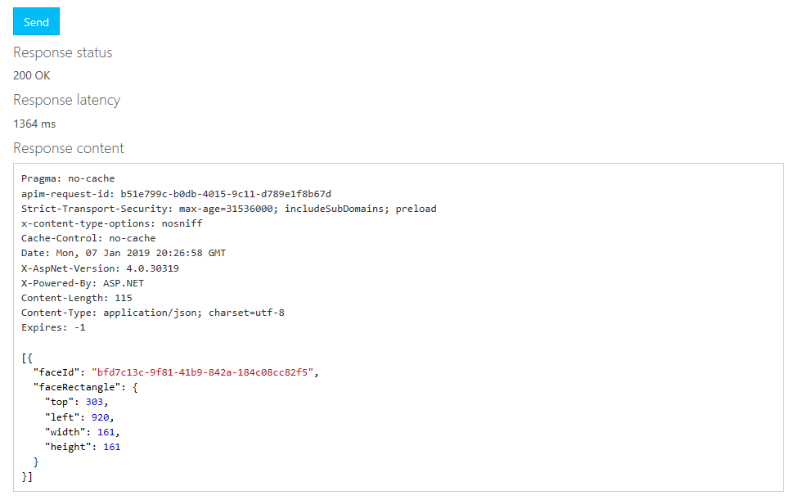
The API Testing Console
Notes:
We're going to use the Cognitive Services testing console. The testing console is a built-in website you can use to build and send REST requests for any of the AI services.
Open your Face API subscription.
Copy one of the subscription keys by using the Copy button to the right of the key value.
Open the Face API service page .
In the Face Detect section, select the Open API testing console button that's associated with the location where you created your Azure service. For example, if you used WestUS, in the testing console section, select West US. In the testing page that opens, you can enter the parameters you want to send to the service, submit the request, and then see the response right in the browser.
Scroll down to the Headers section and paste your subscription key in the Ocp-Apim-Subscription-Key text box.
Locate an image that includes a face. You can use your own image URL, or use this one:
In the Request body section of the tester, paste the URL as a JSON block. Here we're using the image URL from the previous step. If you want to use your own image, replace the url value that's shown here:
JSONCopy
{ "url": "https://docs.microsoft.com/learn/data-ai-cert/identify-faces-with-computer-vision/media/clo19_ubisoft_azure_068.png" }
Select Send.

Slide 43

Lab 1: Meeting the Technical Requirements

Slide 44
Lab Objectives
L01 – Configure the lab environment
L02 – Download necessary support files and assets

Slide 45
Lab 2: Implement Computer Vision

Slide 46
Lab Objectives
L01 – Work with the Computer Vision API

Slide 47
Lab Scenario
In this lab you learn how to implement the Computer Vision API. We use the ImageProcessing portable class library (PCL), discussing its contents and how to use it in your own applications.

Slide 48

Next steps
Module Summary
In this module, you have learned about:
Microsoft Azure Cognitive Services
What Computer Vision is
What the Speech Services are
What the Language Services are
Bing Search Services
What Decision Services are available
After the course, consider researching the other aspects of the Azure Cognitive Services and trying the samples presented on the site.

